Slide 1


CSCE 692 Design Principles of Computer Architecture Lecture 5a Chap 5 – Multiprocessors &
Thread Level Parallelism
(5.1 - 5.3)
Dr. Scott Graham
AFIT/ENG
Notes adapted from
David Patterson
Electrical Engineering and Computer Sciences
University of California, Berkeley

Slide 2
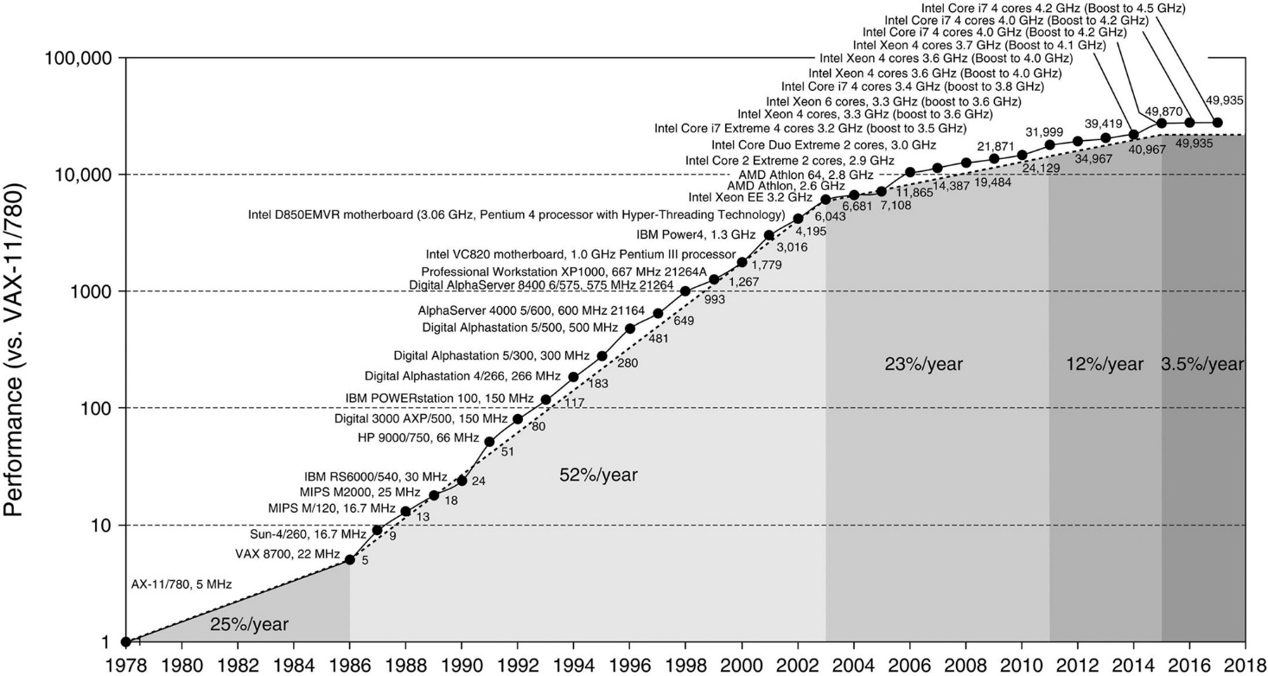
Crossroads: Uniprocessor Performance
From Hennessy and Patterson, Computer Architecture: A Quantitative Approach, 6th edition, Nov, 2017
VAX : 25%/year 1978 to 1986
RISC + x86: 52%, 23%, 12%, /year 1986 to 2015
RISC + x86: 3.5%/year 2015 to present
Notes:
Till about the mid 80-s, processor performance more technology driven (e.g., transistors, EE stuff)
From 86-2002, most advances came from architectural designs and ILP – still some from technological and also a big increase from advances in floating point.
Now – hit a wall due to not much more out of ILP, memory lag times, power, etc.

Slide 3
Banging your head on a brick wall
Power
Memory
ILP
TLP & Multi-core/processors to the rescue!

Slide 4
Déjà vu all over again & again?
“… today’s processors … are nearing an impasse as technologies approach the speed of light..”
David Mitchell, The Transputer: The Time Is Now (1989)
Transputer had bad timing (Uniprocessor performance↑) ⇒ Procrastination rewarded: 2X seq. perf. / 1.5 years
“We are dedicating all of our future product development to multicore designs. … This is a sea of change in computing”
Paul Otellini, President, Intel (2005)
All microprocessor companies switch to MP (2X CPUs / 2 yrs) ⇒ Procrastination penalized: 2X sequential perf. / 5 yrs
Manufacturer/Year | AMD/’05 | Intel/’06 | IBM/’04 | Sun/’05
Processors/chip | 2 | 2 | 2 | 8
Threads/Processor | 1 | 2 | 2 | 4
Threads/chip | 2 | 4 | 4 | 32

Slide 5
Other Factors ⇒ Multiprocessors
Growth in data-intensive applications
Data bases, file servers, …
Growing interest in servers, server perf.
Increasing desktop perf. less important
Outside of graphics
Improved understanding in how to use multiprocessors effectively
Especially server where significant natural TLP
Advantage of leveraging design investment by replication
Rather than unique design

Slide 6
Flynn’s Taxonomy
M.J. Flynn, "Very High-Speed Computers", Proc. of the IEEE, V 54, 1900-1909, Dec. 1966.
Flynn classified parallelism by data and control streams in 1966
SIMD ⇒ Data Level Parallelism
MIMD ⇒ Thread Level Parallelism
Current multiprocessor/multicore focus
Single Instruction Single Data (SISD) (Uniprocessor) | Single Instruction Multiple Data (SIMD) (single PC: Vector, CM-2)
Multiple Instruction Single Data (MISD) (????) | Multiple Instruction Multiple Data (MIMD) (Clusters, multiprocessors, multicore)
Notes:
a Connection Machine 5 (CM-5) supercomputer used by the US National Security Agency (NSA) to perform higher-level mathematical calculations. The CM-5 was built by the Thinking Machines Corporation,

Slide 7
Back to Basics
“A parallel computer is a collection of processing elements that cooperate and communicate to solve large problems fast.”
Parallel Architecture = Computer Architecture + Communication Architecture
2 classes of multiprocessors WRT memory:
Centralized Memory Multiprocessor
< few dozen processor chips (and < 100 cores) in 2006
Small enough to share single, centralized memory
Physically Distributed-Memory Multiprocessor
Larger number chips and cores than 1.
BW demands ⇒ Memory distributed among processors

Slide 8
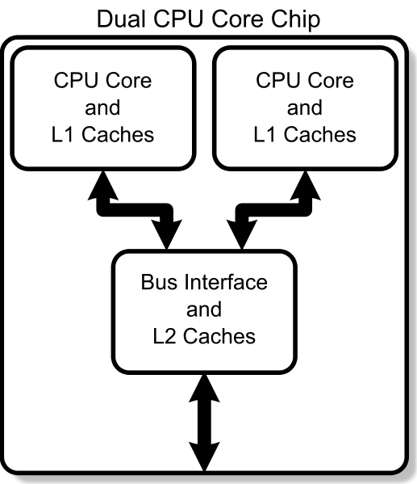
Centralized vs. Distributed Memory
Scale
P
P
P
P
n
1
n
1
$
$
$
$
Mem
Mem
BUS
Interconnection network
Mem
Centralized Memory
Distributed Memory
Where do Multi-cores fit?

Slide 9
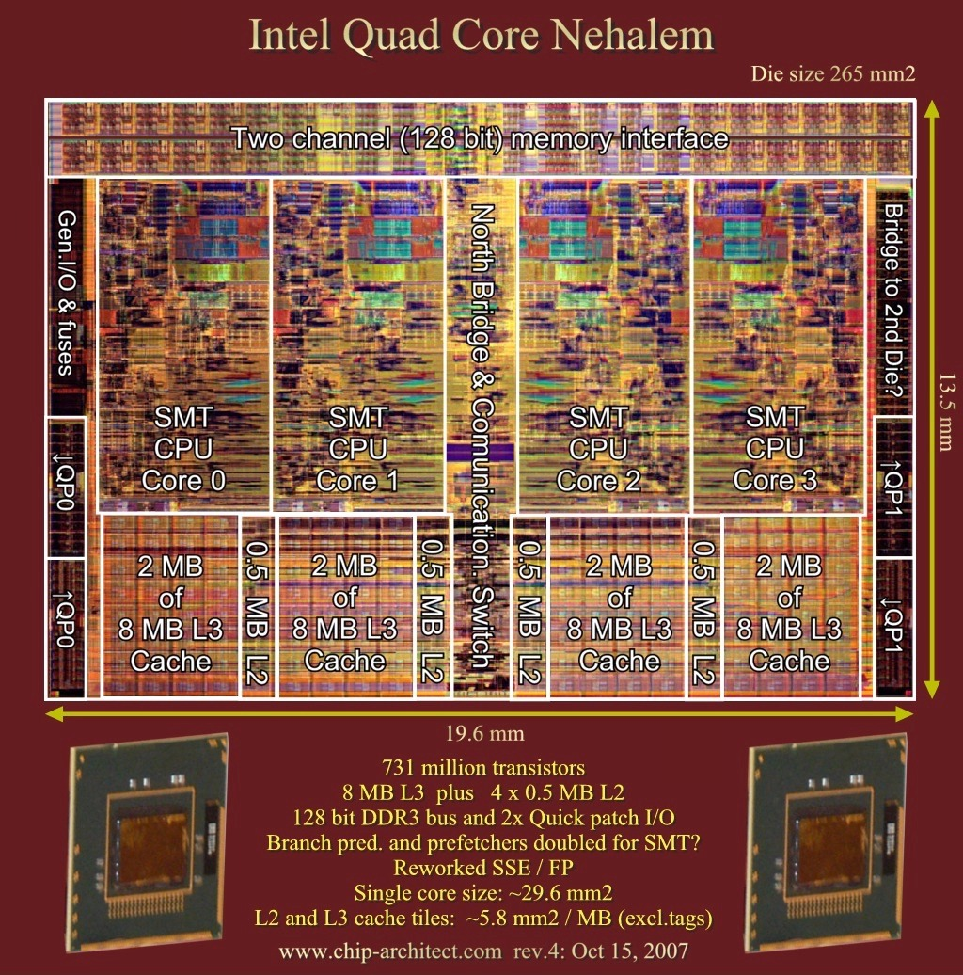
Modern Processor On-board Cache
Notes:
L1 caches (per core)
L1 I-cache: 32KB, 64-byte blocks, 4-way, approx LRU replacement, hit time n/a
L1 D-cache: 32KB, 64-byte blocks, 8-way, approx LRU replacement, write-back/allocate, hit time n/a
L2 unified cache (per core)
256KB, 64-byte blocks, 8-way, approx LRU replacement, write-back/allocate, hit time n/a
L3 unified cache (shared)
8MB, 64-byte blocks, 16-way, replacement n/a, write-back/allocate, hit time n/a

Slide 10
Centralized Memory Multiprocessor
Also called symmetric multiprocessors (SMPs) because single main memory has a symmetric relationship to all processors
Sometimes referred to as UMAs (Uniform memory access)
Large caches ⇒ single memory can satisfy memory demands of small number of processors
Can scale to a few dozen processors by using a switch and by using many memory banks
Although scaling beyond that is technically conceivable, it becomes less attractive as the number of processors sharing centralized memory increases
Notes:
UMA because memory latency uniform to any processor/core.

Slide 11
Distributed Memory Multiprocessor
Adding local memory per processors, then sharing between processors as required.
Also referred to as NUMAs (Non-Uniform memory access)
Pro: Cost-effective way to scale memory bandwidth
If most accesses are to local memory
Pro: Reduces latency of local memory accesses
Con: Communicating data between processors more complex
Con: Must change software to take advantage of increased memory BW

Slide 12
2 Models for Communication and Memory Architecture
Communication occurs by explicitly passing messages among the processors: message-passing multiprocessors
Implicit Communication occurs through a shared address space (via loads and stores): shared memory multiprocessors either
UMA (Uniform Memory Access time) for shared address, centralized memory MP
NUMA (Non Uniform Memory Access time multiprocessor) for shared address, distributed memory MP
Also called Distributed Shared Memory (DSM)
Notes:
For Distributed Memory Multiprocessors can use either communication model 1 or model 2 as NUMA.
Central Memory Multiprocessors are UMA only.
Systran SCRAMNet Example
Shared memory multiprocessors use a unique physical address for all locations regardless of what machine it is one (NUMA reference is to a unique location on a unique machine). Message-passing communication systems can all each use their own address not referencing other computers other than through messages.

Slide 13

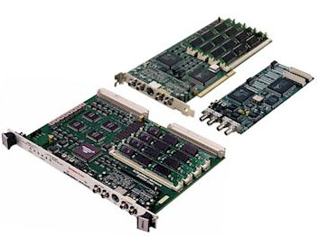

Distributed NUMA example - SCRAMNet
Full hardware solution providing replicated memory and
sub-microsecond <10 ⁻⁶ so can almost consider UMA.
Notes:
Recall SCRAMnet from VACD – actually replicated memory and actually sub-microsecond <10^-6 so can almost consider UMA.
Not really even quite fully distributed as each node replicates the same memory address/content but an actual good example of the general idea

Slide 14
Challenges of Parallel Processing
First challenge is the existing % of program which is inherently sequential (i.e., overhead)
Example:
Suppose want 80X speedup from 100 processors
What fraction of original program can be sequential?
10%
5%
1%
<1%
Amdahl’s Law Still Applies!
Notes:
Note that we cannot just infinitely add processors to a parallel program and continue to gain speedup, since portions of programs must maintain some sequential operations (can’t eliminate all dependencies)
Work out example on board.

Slide 15
Amdahl’s Law on Overhead

Slide 16
Challenges of Parallel Processing
Second challenge is long latency to remote memory
Example
32 CPU MP with 2GHz clock (0.5ns)
200ns remote memory (200ns/0.5ns = 400 cycles)
All local accesses hit memory hierarchy
Base CPI is 0.5
Calculate CPI performance impact if only 0.2% of instructions involve remote access
1.5X
2.0X
2.6X
Notes:
Work out example on board

Slide 17
Impact of Latency
CPI = Base CPI +
remote request rate x request cost
CPI = 0.5cc + 0.2% x 400cc = 0.5 + 0.8 = 1.3
New CPI = 1.3/0.5 = 2.6 larger
0.2% remote access drops speed by 62%

Slide 18
Challenges of Parallel Processing
Application parallelism ⇒ primarily via new algorithms that have better parallel performance
Long remote latency impact ⇒ both by architect and by the programmer
For example, reduce frequency of remote accesses either by
Caching shared data (HW)
Restructuring the data layout to make more accesses local (SW)
Let’s focus on the hardware solution

Slide 19
Symmetric Shared-Memory Architectures
From multiple boards on a shared bus to multiple processors inside a single chip
Caches both
Private data used by a single processor
Shared data used by multiple processors
Caching shared data ⇒ reduces latency to shared data, memory bandwidth for shared data, and interconnect bandwidth ⇒ cache coherence problem

Slide 20
Example Cache Coherence Problem
P
P
P
1
2
3
u
= ?
u
= ?
3
$
4
$
5
$
u
:5
u
:5
u
= 7
1
I/O devices
u
:5
2
Memory
Processors see different values for u after event 3
With write-back caches, value written back to memory depends on happenstance of which cache flushes or writes back value
Processes accessing main memory may see very stale value
Unacceptable for programming, and all too frequent!

Slide 21
Intuitive Memory Model
P
Reading an address should return the last value written to that address
Easy in uniprocessors, except for I/O
L1
100:67
L2
100:34
Memory
Disk
100:34
Too vague and simplistic; 2 issues
Coherence defines values returned by a read
Consistency determines when a written value will be returned by a read
Coherence defines behavior to same location, Consistency defines behavior to other locations

Slide 22
Example
P
1
P
2
/*Assume initial value of A and flag is 0*/
A = 1;
while (flag == 0);
/*spin idly*/
flag = 1;
print A;
Intuition not guaranteed by coherence
Expect memory to respect order between accesses to different locations issued by a given process
to preserve orders among accesses to same location by different processes
Coherence is not enough!
pertains only to single location
P
P
1
n
Conceptual
Picture
Mem

Slide 23
Defining Coherent Memory System
Preserve Program Order: A read by processor P to location X that follows a write by P to X, with no writes of X by another processor occurring between the write and the read by P, always returns the value written by P
Coherent view of memory: Read by a processor to location X that follows a write by another processor to X returns the written value if the read and write are sufficiently separated in time and no other writes to X occur between the two accesses
Write serialization: 2 writes to same location by any 2 processors are seen in the same order by all processors
If not, a processor could keep value 1 since saw as last write
For example, if the values 1 and then 2 are written to a location, processors can never read the value of the location as 2 and then later read it as 1

Slide 24
Write Consistency
For now assume
A write does not complete (and allow the next write to occur) until all processors have seen the effect of that write
The processor does not change the order of any write with respect to any other memory access
⇒ if a processor writes location A followed by location B, any processor that sees the new value of B must also see the new value of A
These restrictions allow the processor to reorder reads, but forces the processor to finish writes in program order

Slide 25
Basic Schemes for Enforcing Coherence
Program on multiple processors will normally have copies of the same data in several caches
Unlike I/O, where its rare
Rather than trying to avoid sharing in SW, SMPs use a HW protocol to maintain coherent caches
Migration and Replication key to performance of shared data
Migration - data can be moved to a local cache and used there in a transparent fashion
Reduces both latency to access shared data that is allocated remotely and bandwidth demand on the shared memory
Replication – for shared data being simultaneously read, since caches make a copy of data in local cache
Reduces both latency of access and contention for read shared data

Slide 26
2 Classes of Cache Coherence Protocols
Directory based — Sharing status of a block of physical memory is kept in just one location, the directory
Scales well – common for distributed shared memory systems
However, is used in Sun T1-Niagara (a symmetric shared memory system)
Snooping — Every cache with a copy of data also has a copy of sharing status of block, but no centralized state is kept
All caches are accessible via some broadcast medium (a bus or switch)
All cache controllers monitor or snoop on the medium to determine whether or not they have a copy of a block that is requested on a bus or switch access

Slide 27
Snoopy Cache-Coherence Protocols
State
Address
Data
Cache Controller “snoops” all transactions on the shared medium (bus or switch)
relevant transaction if for a block it contains
take action to ensure coherence
invalidate, update, or supply value
depends on state of the block and the protocol
Either get exclusive access before write via write invalidate or update all copies on write

Slide 28
Example: Write-thru Invalidate
P
P
P
1
2
3
u
= ?
u
= ?
3
$
4
$
5
$
u
:5
u
:5
u
= 7
1
I/O devices
u
:5
2
u = 7
Memory
Must invalidate before step 3
Write update uses more broadcast medium BW ⇒ all recent multiprocessors use write invalidate
What about Write-back Invalidate
Notes:
Also mention write-update (not used)

Slide 29
Architectural Building Blocks
Cache block state transition diagram
FSM specifying how disposition of block changes
invalid, valid, dirty
Broadcast Medium Transactions (e.g., bus)
Fundamental system design abstraction
Logically single set of wires connect several devices
Protocol: arbitration, command/addr, data
Every device observes every transaction
Broadcast medium enforces serialization of read or write accesses ⇒ Write serialization
1st processor to get medium invalidates others copies
Implies cannot complete write until it obtains bus
All coherence schemes require serializing accesses to same cache block
Also need to find up-to-date copy of cache block

Slide 30
Locate up-to-date copy of data
Write-through: get up-to-date copy from memory
Write through simpler if enough memory BW
Write-back: harder
Most recent copy can be in a cache
Can use same snooping mechanism
Snoop every address placed on the bus
If a processor has dirty copy of requested cache block, it provides it in response to a read request and aborts the memory access
Complexity from retrieving cache block from a processor cache, which can take longer than retrieving it from memory
Write-back needs lower memory bandwidth ⇒ Support larger numbers of faster processors ⇒ Most multiprocessors use write-back

Slide 31
Cache Resources for WB Snooping
Normal cache tags can be used for snooping
Valid bit per block makes invalidation easy
Read misses easy since rely on snooping
Writes ⇒ Need to know whether any other copies of the block are cached
No other copies ⇒ No need to place write on bus for WB
Other copies ⇒ Need to place invalidate on bus

Slide 32
Cache Resources for WB Snooping
To track whether a cache block is shared, add extra state bit associated with each cache block, like valid bit and dirty bit
Write to Shared block ⇒ Need to place invalidate on bus and mark cache block as private (if an option)
No further invalidations will be sent for that block
This processor called owner of cache block
Owner then changes state from shared to unshared (or exclusive)
State
Address
Data
Notes:
valid, dirty, share

Slide 33
Cache behavior in response to bus
Every bus transaction must check the cache-address tags
could potentially interfere with processor cache accesses
A way to reduce interference is to duplicate tags
One set for caches access, one set for bus accesses
Another way to reduce interference is to use L2 tags
Since L2 less heavily used than L1
⇒ Every entry in L1 cache must be present in the L2 cache, called the inclusion property
If Snoop gets a hit in L2 cache, then it must arbitrate for the L1 cache to update the state and possibly retrieve the data, which usually requires a stall of the processor

Slide 34
Example Write Back Snoopy Protocol
Invalidation protocol, write-back cache
Snoops every address on bus
If it has a dirty copy of requested block, provides that block in response to the read request and aborts the memory access
Each memory block is in one state:
Clean in all caches and up-to-date in memory (Shared)
OR Dirty in exactly one cache (Exclusive)
OR Not in any caches
Each cache block is in one state (track these):
Shared : block can be read
OR Exclusive : cache has only copy, its writeable, and dirty
OR Invalid : block contains no data (in uniprocessor cache too)
Read misses: cause all caches to snoop bus
Writes to clean blocks are treated as misses

Slide 35
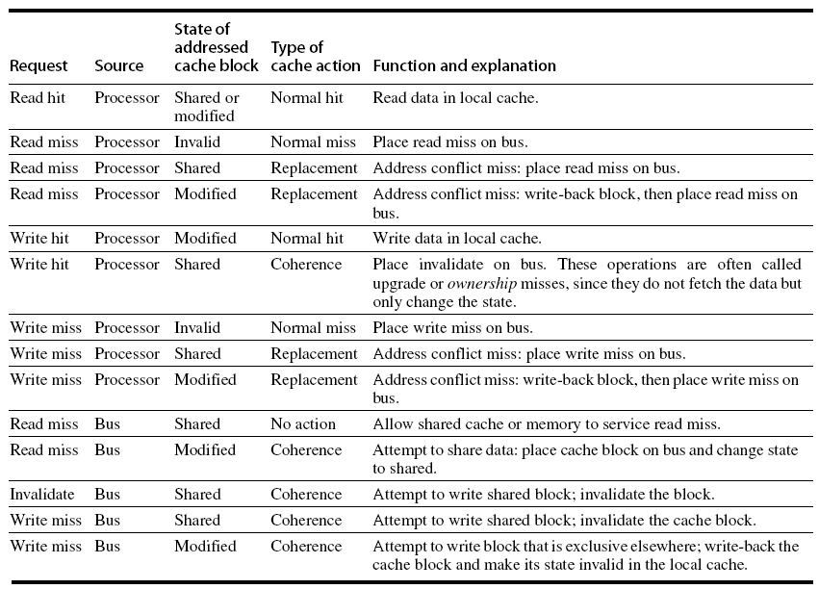
Snoopy Protocol Actions
Modified implies exclusive
Note the source of the request

Slide 36
State Machine per Cache Block
CPU Read Hit
CPU Read (Miss)
Shared
(read/only)
Invalid
Place Read Miss on bus
CPU Read (Miss)
Place Read Miss on bus
CPU Write
CPU Read (Miss)
Write back block,
Place Read
Miss on
bus
Place Write Miss on bus
CPU Write
Hit: Place Invalidate on Bus
Miss: Place Write Miss on bus
Exclusive
(read/write)
CPU Read (Hit)
CPU Write (Hit)
CPU Write (Miss)
Write back cache block
Place Write Miss on bus
Notes:
Invalid:
read => shared
write => dirty
shared looks the same

Slide 37
Write-Back State Machine- Bus request
State machine for bus requests for each cache block
Write Miss for this block
Invalid
Shared
(read/only)
Invalidate for this block
Write Miss for this block
Write Back
Block; (abort
memory access)
Read Miss for this block
Write Back
Block; (abort
memory access)
Exclusive
(read/write)

Slide 38
Example
Assumptions:
A1 and A2 map to same cache block (but A1 != A2)
Initial cache state (for this block) is Invalid
 | P1 |  |  | P2 |  |  | Bus |  |  |  | Memory
step | State | Addr | Value | State | Addr | Value | Action | Proc. | Addr | Value | Addr | Value
P1: Write 10 to A1
P1: Read A1
P2: Read A1
P2: Write 20 to A1
P2: Write 40 to A2

Slide 39
Example
Assumptions:
A1 and A2 map to same cache block (but A1 != A2)
 | P1 |  |  | P2 |  |  | Bus |  |  |  | Memory
step | State | Addr | Value | State | Addr | Value | Action | Proc. | Addr | Value | Addr | Value
P1: Write 10 to A1 | Excl. | A1 | 10 |  |  |  | WrMs | P1 | A1
P1: Read A1
P2: Read A1
P2: Write 20 to A1
P2: Write 40 to A2

Slide 40
Example
Assumptions:
A1 and A2 map to same cache block (but A1 != A2)
 | P1 |  |  | P2 |  |  | Bus |  |  |  | Memory
step | State | Addr | Value | State | Addr | Value | Action | Proc. | Addr | Value | Addr | Value
P1: Write 10 to A1 | Excl. | A1 | 10 |  |  |  | WrMs | P1 | A1
P1: Read A1 | Excl. | A1 | 10
P2: Read A1
P2: Write 20 to A1
P2: Write 40 to A2

Slide 41
Example
Assumptions:
A1 and A2 map to same cache block (but A1 != A2)
 | P1 |  |  | P2 |  |  | Bus |  |  |  | Memory
step | State | Addr | Value | State | Addr | Value | Action | Proc. | Addr | Value | Addr | Value
P1: Write 10 to A1 | Excl. | A1 | 10 |  |  |  | WrMs | P1 | A1
P1: Read A1 | Excl. | A1 | 10
P2: Read A1 |  |  |  | Shar. | A1 |  | RdMs | P2 | A1
 | Shar. | A1 | 10 |  |  |  | WrBk | P1 | A1 | 10 | A1 | 10
 |  |  |  | Shar. | A1 | 10 | RdDa | P2 | A1 | 10 | A1 | 10
P2: Write 20 to A1
P2: Write 40 to A2

Slide 42
Example
Assumptions:
A1 and A2 map to same cache block (but A1 != A2)
 | P1 |  |  | P2 |  |  | Bus |  |  |  | Memory
step | State | Addr | Value | State | Addr | Value | Action | Proc. | Addr | Value | Addr | Value
P1: Write 10 to A1 | Excl. | A1 | 10 |  |  |  | WrMs | P1 | A1
P1: Read A1 | Excl. | A1 | 10
P2: Read A1 |  |  |  | Shar. | A1 |  | RdMs | P2 | A1
 | Shar. | A1 | 10 |  |  |  | WrBk | P1 | A1 | 10 | A1 | 10
 |  |  |  | Shar. | A1 | 10 | RdDa | P2 | A1 | 10 | A1 | 10
P2: Write 20 to A1 | Inv. |  |  | Excl. | A1 | 20 | Inv. | P2 | A1 |  | A1 | 10
P2: Write 40 to A2

Slide 43
Example
Assumptions:
A1 and A2 map to same cache block (but A1 != A2)
 | P1 |  |  | P2 |  |  | Bus |  |  |  | Memory
step | State | Addr | Value | State | Addr | Value | Action | Proc. | Addr | Value | Addr | Value
P1: Write 10 to A1 | Excl. | A1 | 10 |  |  |  | WrMs | P1 | A1
P1: Read A1 | Excl. | A1 | 10
P2: Read A1 |  |  |  | Shar. | A1 |  | RdMs | P2 | A1
 | Shar. | A1 | 10 |  |  |  | WrBk | P1 | A1 | 10 | A1 | 10
 |  |  |  | Shar. | A1 | 10 | RdDa | P2 | A1 | 10 | A1 | 10
P2: Write 20 to A1 | Inv. |  |  | Excl. | A1 | 20 | Inv. | P2 | A1 |  | A1 | 10
P2: Write 40 to A2 |  |  |  |  |  |  | WrMs | P2 | A2 |  | A1 | 10
 |  |  |  | Excl. | A2 | 40 | WrBk | P2 | A1 | 20 | A1 | 20

Slide 44
Implementation Complications
Write Races:
Cannot update cache until bus is obtained
Otherwise, another processor may get bus first, and then write the same cache block!
Two step process:
Arbitrate for bus
Place miss on bus and complete operation
If miss occurs to block while waiting for bus, handle miss (invalidate may be needed) and then restart.
Split transaction bus:
Bus transaction is not atomic: can have multiple outstanding transactions for a block
Multiple misses can interleave, allowing two caches to grab block in the Exclusive state
Must track and prevent multiple misses for one block
Must support interventions and invalidations

Slide 45
Implementing Snooping Caches
Multiple processors must be on bus, access to both addresses and data
Add a few new commands to perform coherency, in addition to read and write
Processors continuously snoop on address bus
If address matches tag, either invalidate or update
Since every bus transaction checks cache tags, could interfere with CPU just to check:
solution 1: duplicate set of tags for L1 caches just to allow checks in parallel with CPU
solution 2: L2 cache already duplicate, provided L2 obeys inclusion with L1 cache
block size, associativity of L2 affects L1

Slide 46
Limitations in Symmetric Shared-Memory Multiprocessors and Snooping Protocols
Single memory accommodate all CPUs
⇒ Multiple memory banks
Bus-based multiprocessor, bus must support both coherence traffic & normal memory traffic
⇒ Multiple buses or interconnection networks (cross bar or small point-to-point)
Opteron
Memory connected directly to each dual-core chip
Point-to-point connections for up to 4 chips
Remote memory and local memory latency are similar, allowing OS Opteron as UMA computer

Slide 47
Performance of Symmetric Shared-Memory Multiprocessors
Cache performance is combination of
Uniprocessor cache miss traffic
Traffic caused by communication
Results in invalidations and subsequent cache misses
4th C: coherence miss
Joins Compulsory, Capacity, Conflict

Slide 48
Coherency Misses
True sharing misses arise from the communication of data through the cache coherence mechanism
Invalidates due to 1st write to shared block
Reads by another CPU of modified block in different cache
Miss would still occur if block size were 1 word
False sharing misses when a block is invalidated because some word in the block, other than the one being read, is written into
Invalidation does not cause a new value to be communicated, but only causes an extra cache miss
Block is shared, but one word in block is actually shared ⇒ miss would not occur if block size were 1 word

Slide 49
Example: True v. False Sharing v. Hit?
Assumptions:
x1 and x2 in same cache block.
P1 and P2 both read x1 and x2 before.
Time | P1 | P2 | True, False, Hit? Why?
1 | Write x1
2 |  | Read x2
3 | Write x1
4 |  | Write x2
5 | Read x2
True miss; invalidate x1 in P2
False miss; x1 irrelevant to P2
False miss; x1 irrelevant to P2
False miss; x1 irrelevant to P2
True miss; invalidate x2 in P1

Slide 50
MP Performance 4 Processor, Commercial Workload: OLTP, Decision Support (Database), Search Engine
Uniprocessor cache misses improve with cache size increase
Instruction, Capacity/Conflict, Compulsory
True and false sharing largely unchanged from 1 to 8 MB (L3 cache)
However, as we increase processors…
(Memory) Cycles per Instruction
L3
Notes:
4 processor Alpha Server with each processor supporting 4 issues/cycle

Slide 51
MP Performance 2MB L3 Cache Commercial Workload: OLTP, Decision Support (Database), Search Engine
True and false sharing increase going from 1 to 8 CPUs
(Memory) Cycles per Instruction

Slide 52
And in Conclusion
“End” of uniprocessors speedup ⇒ Multiprocessors
Parallelism challenges
Parallelizability
Long latency to remote memory
Centralized vs. distributed memory
Small MP vs. lower latency, larger BW for Larger MP
Message Passing vs. Shared Address
Uniform access time vs. Non-uniform access time
Snooping cache over shared medium for smaller MP by invalidating other cached copies on write
Sharing cached data challenges
Coherence (values returned by a read),
Consistency (when a written value will be returned by a read)
Shared medium serializes writes ⇒ Write consistency

